Slide 1

Exploratory Data Analysis
G2M insight for Cab Investment firm
July 14, 2022
Shovan Roy

Slide 2

Agenda
Executive Summary
Problem Statement
Approach
EDA
EDA Summary
Recommendations

Slide 3

Executive Summary
XYZ aims to expand their investments into the Cab industry, Due to a remarkable growth in the industry in the past few years. The likely prospects to receive these investments are the yellow and the pink Cab Company.
This Presentation aims to provide insights into these company's performance over the last few years and choose the best candidate for XYZ’s investment into the Cab Industry.

Slide 4
Problem Statement
Which would be the most suitable Cab company to Invest in for Consistent and High Return on Investments(ROI)?

Slide 5
Approach
Data Collection of both companies of the past few years
Cleaning and preparation of the data from Exploratory Data Analysis(EDA)
Comparison and form Insights of these data during EDA
Forming Conclusion on with company is best for investment through these insights

Slide 6
EDA

Slide 7
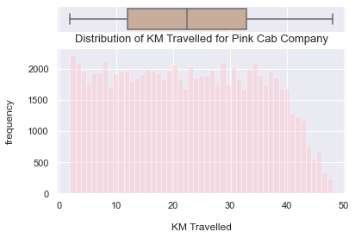
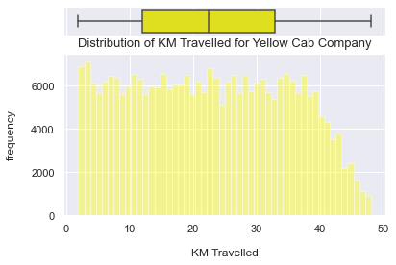
Distribution of ‘KM travelled’ feature for both Companies
Most of the rides for both companies vary from 2 to 48 KM.
Yellow Cab Company has more frequent rides than the Pink cab company.

Slide 8
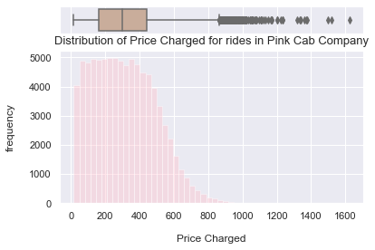
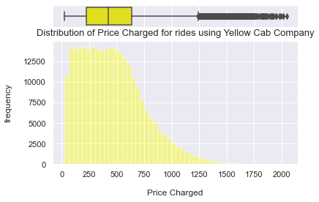
Distribution of ‘Price Charged’ feature for both Companies
The price charged for Pink cab company ranges between : 15.6 $ and 1623.48 $
The price charged for Yellow cab company ranges between : 20.73 $ and 2048.03 $
The price charged range for Yellow cab company is higher than the Pink cab company.

Slide 9
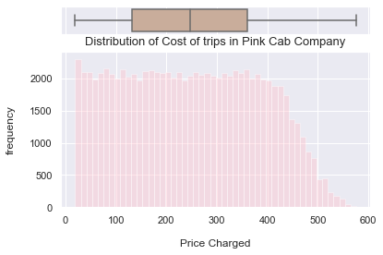
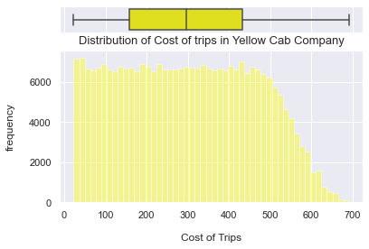
Distribution of ‘Cost of Trip’ feature for both Companies
The cost for Pink cab company ranges between 19.0 $ and 576.0 $
The cost for Yellow cab company ranges between 22.8 $ and 691.2 $
The Cost of Trip range for Yellow cab company is higher than the Pink cab company (expected since the price charged is also higher)

Slide 10
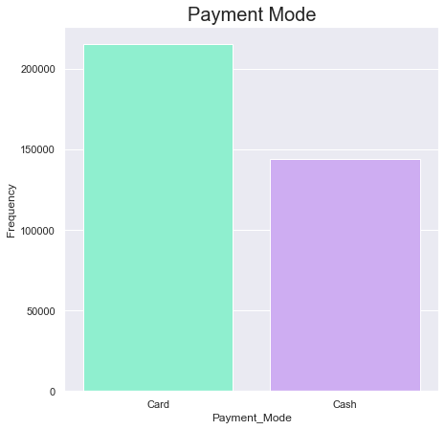
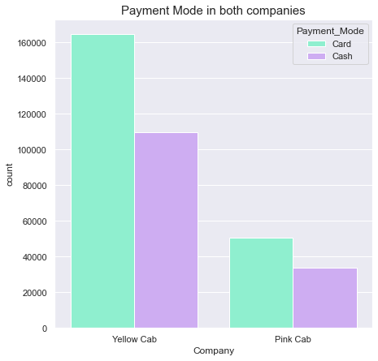
Distribution of ‘Payment mode’ feature for both Companies
Cab users prefer to pay with card for their rides.

Slide 11
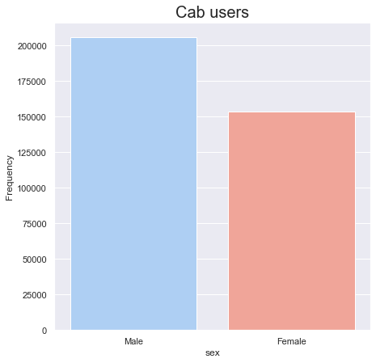
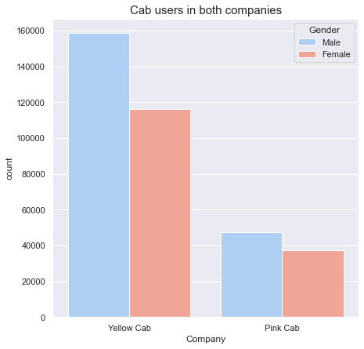
Distribution of ‘Gender’ feature for both Companies
Looks like majority of Female Cab users like taking the Yellow Cab.

Slide 12
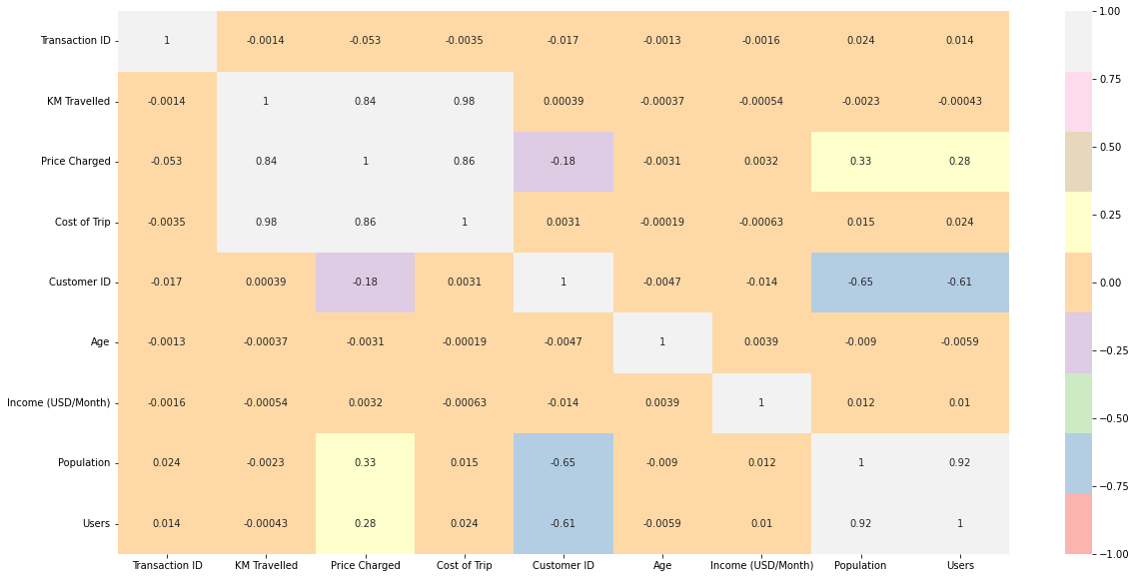
Correlation
There is a positive correlation between ‘Price Charged’ and ‘KM Traveled’ and ‘Cost of Trip’.

Slide 13
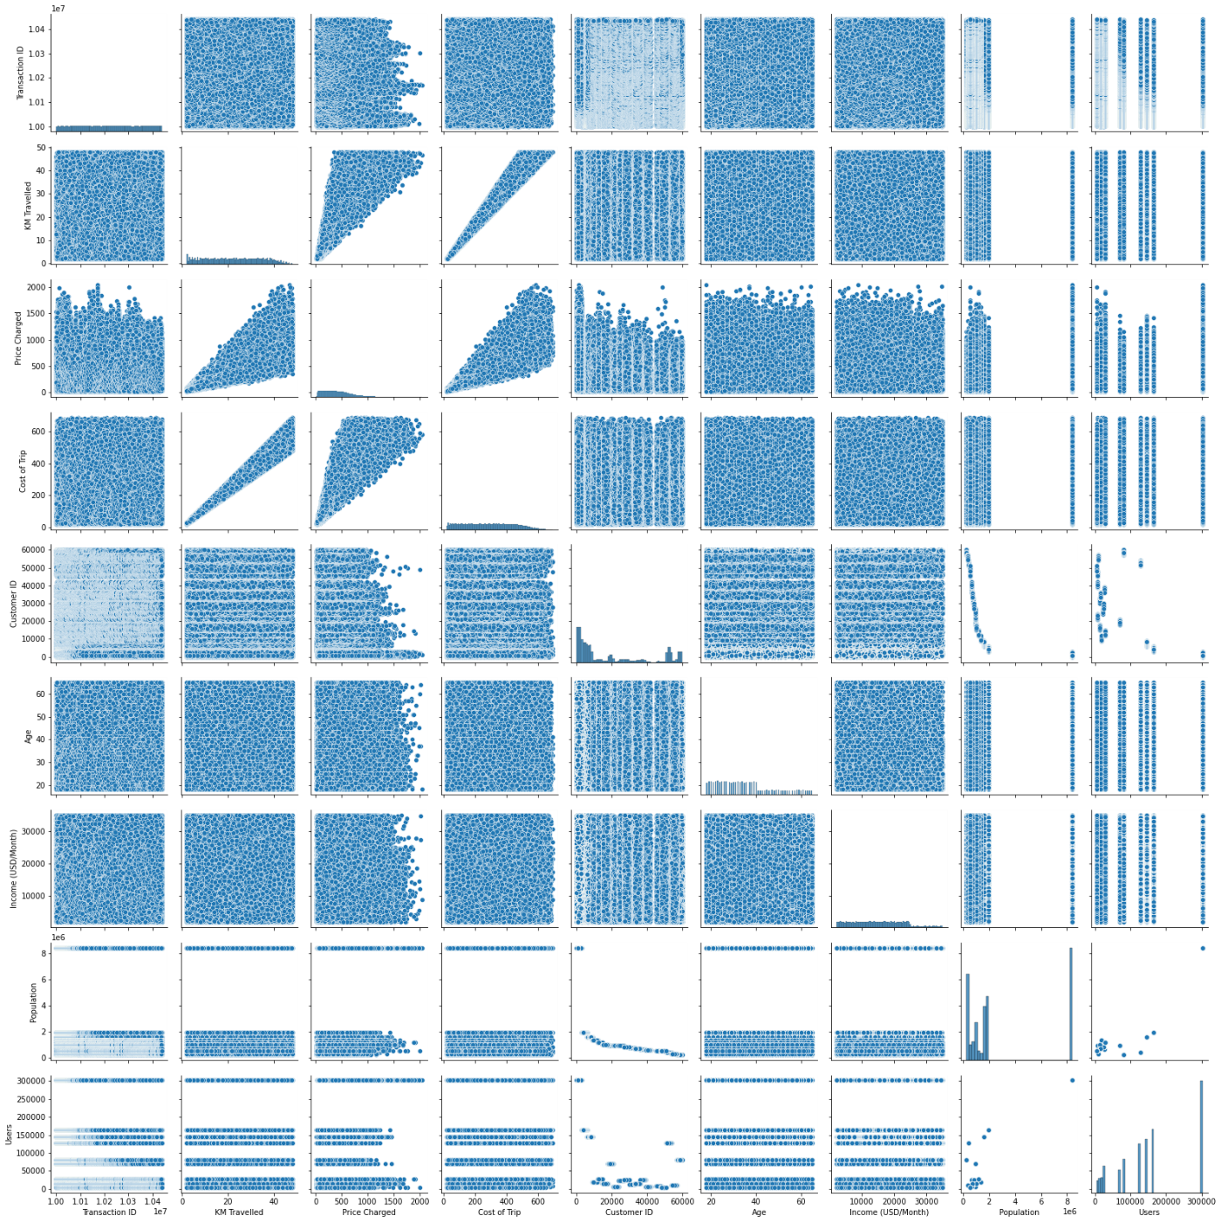
There is a positive correlation between ‘Price Charged’ and ‘KM Traveled’ and ‘Cost of Trip’.

Slide 14
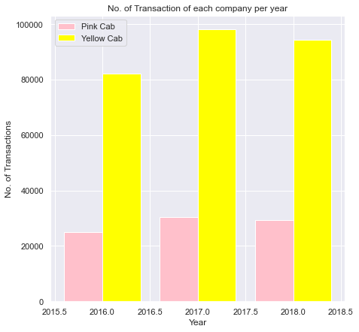
Transaction per year for both Companies
The yellow cab company looks more active than the Pink cab company on a yearly basis.

Slide 15
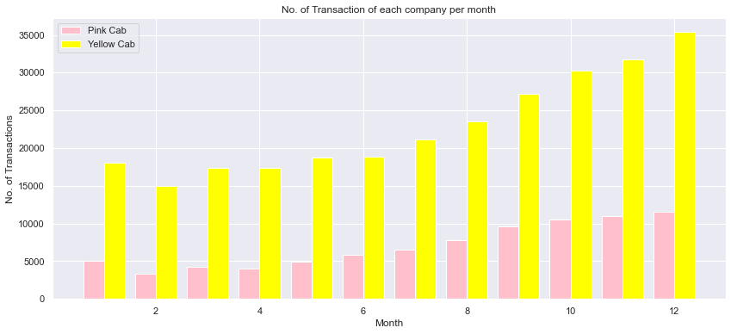
Transactions per month for each company
As we can see from this bar plot, on a monthly basis, Yellow Cab company is in high demand than the pink cab company especially during Holiday season.

Slide 16
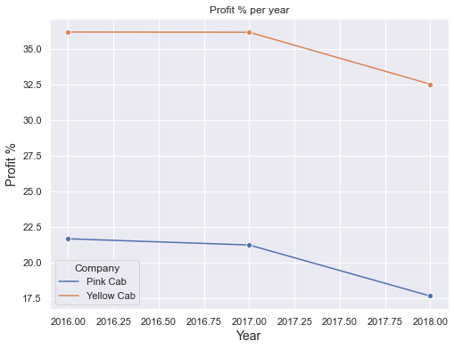
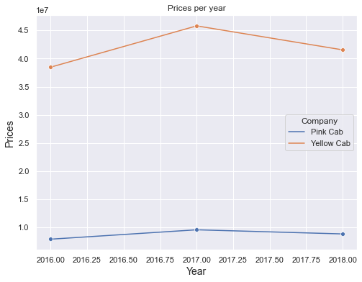
Evolution of Prices and Profit percentage per year
The percentage of the Profit deviation for the Yellow Cab company is 23.07%.
The percentage of the Profit deviation for the Pink Cab company is 61.09 %.

Slide 17
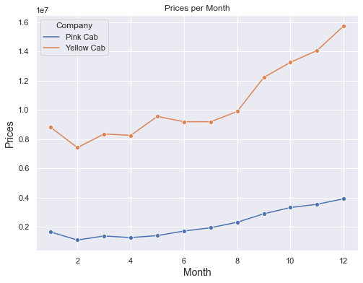
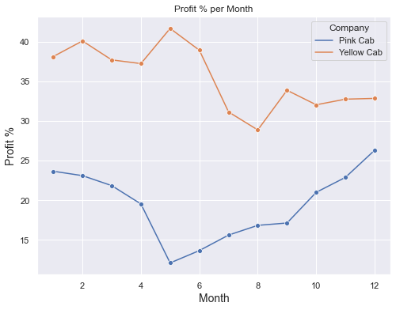
Evolution of Prices and Profit percentage per month
Yellow Cab Company's earnings are more stable, with fluctuations of 23,07%, while those of the Pink Cab Company's vary in the order of 61,09%

Slide 18
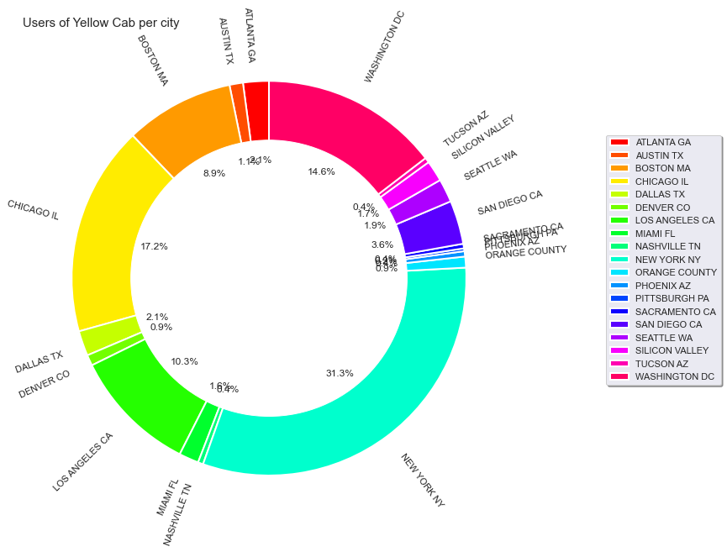
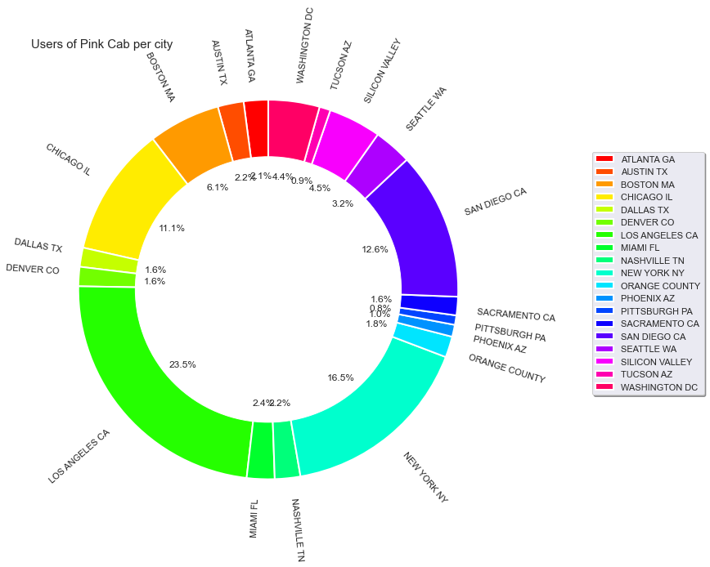
Cab users per city
Transactions for Yellow Cab is highest in New York City which has the highest Cab Users of 47% in total.
Transaction for Pink Cab is highest in Los Angeles CA City with 34% of users in total.

Slide 19
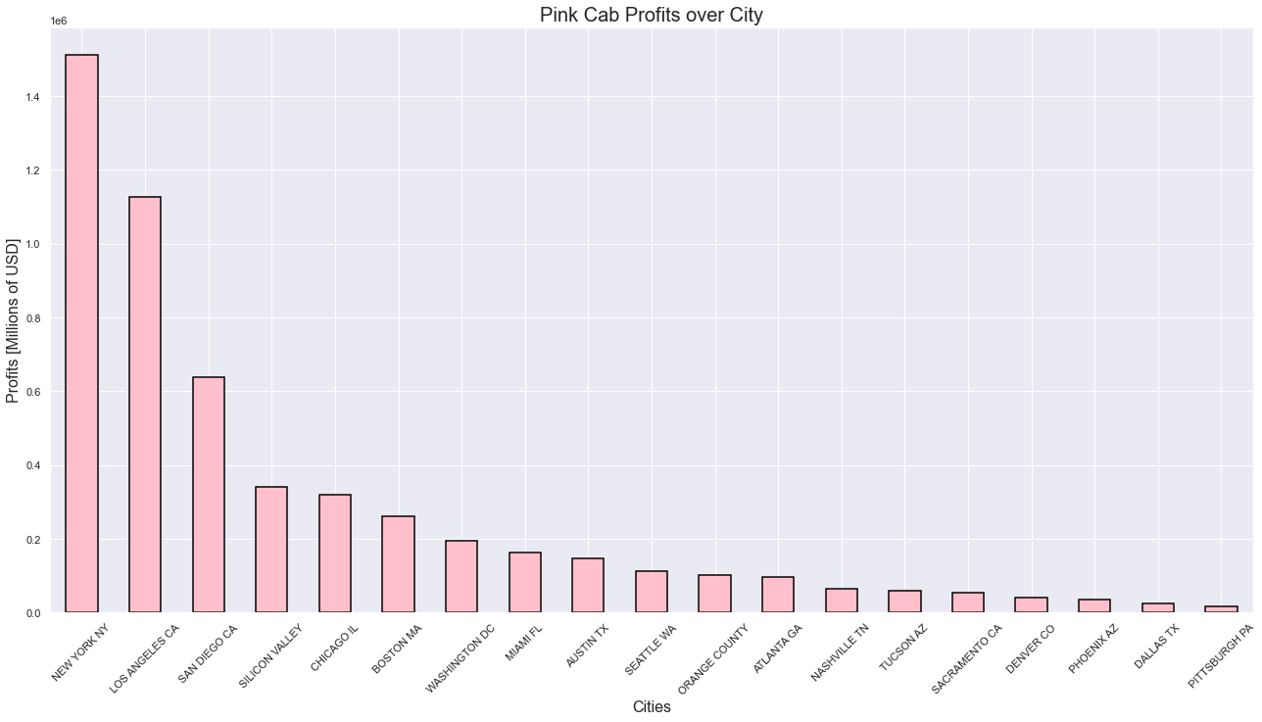
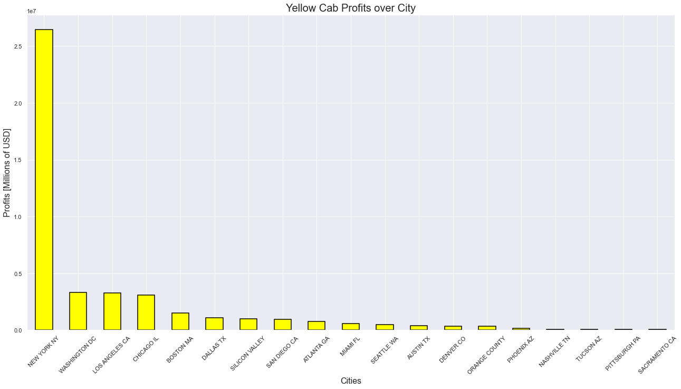
Profit from each city for both companies
New York city holds the highest number of transactions for both companies, hence the profit in Yellow cab company is higher than the Pink cab company in this city.

Slide 20
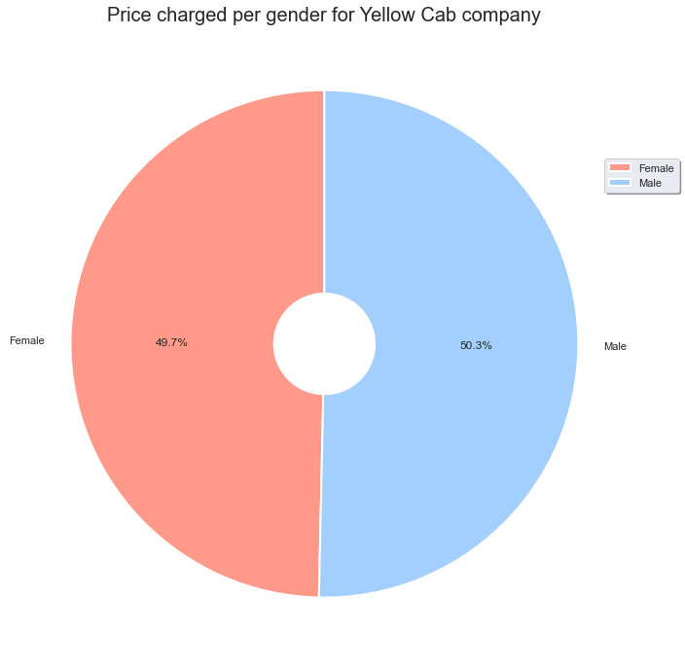
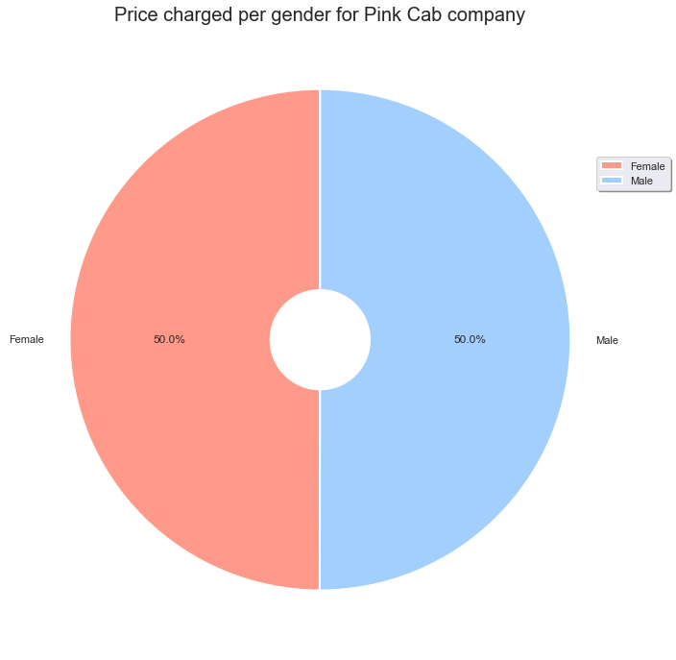
Price Charged per gender in both companies
Yellow Cab charge less from Female Customers whereas Pink Cab charges same for both Male and Female Customers.
Therefore, more Female customers prefer Yellow Cabs.

Slide 21
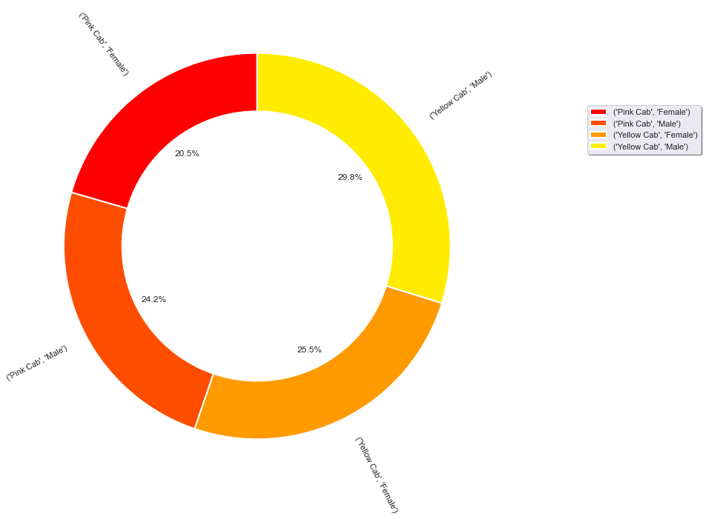
Customer share in Both Companies
Female Customers in Yellow Cab is higher (25.5%) compared to female customers in Pink cab (20.5%).

Slide 22
EDA Summary
Yellow cab company has more frequent rides than the Pink cab company
The price charged range for Yellow company is higher than the Pink cab company.
The cost of trip for the yellow company is higher than the pink company
Majority of female cab users prefer taking the Yellow cab
Cab users preferred mode of payment is card
Yellow cabs are in higher demand than the pink cabs through out the year
Yellow Cab company's earnings are more stable than Pink Cab companies
Yellow cab is most popular in NYC while Pink Cab is most poular in LA
New York is most profitable for yellow cab compared to other cities and also most profitable than any other city pink Cab operates in
Yellow cab gives a Discount to their female Customers, They also have the higher number of Female Users.

Slide 23
Recommendations
Yellow Cab Company has:
Higher Market Share
More Users than Pink Cab
High and consistent Profitability
Demand Throughout the Year
Therefore, The best company for investment.

Slide 24
.
Thank You

